Slide 1
Intro to JS

Slide 2
Agenda
Intro to JavaScript
Toggle CSS with JS
Lab activity: peer review of website

Slide 3
HTML file from first lab
<html>
<head>
<title>Your Name</title>
</head>
<body>
<h1>Your Name</h1>
<p><strong>Welcome to CSCE 315 Lab!</strong></p>
<img src="https://brandguide.tamu.edu/assets/img/logos/tam-box-logo.png"/>
<a href="about.html">About</a>
</body>
</html>

Slide 4
Intro to JavaScript (JS)
JavaScript: scripting language for running client-side code (i.e., in your browser)
Similar syntax to Java/C++:
Comments: //this is a comment
Enclose brackets ({})/semicolon to end lines

Slide 5
Intro to JavaScript (JS) - Types
Different behavior from Java/C++ for variables:
Weakly typed (automatic type conversion):
“1”+1 = “11”
“1”-1 = 0 //???
Boolean:
“1” == 1 //true, abstract equality operator
“1” === 1 //false, strict equality operator
Demo
This can get confusing!

Slide 6
JavaScript functions in HTML file
<html>
<head><title>Your Name</title></head>
<body>
<script>
...
</script>
</body>
</html>

Slide 7
External JS file
<html>
<head><title>Your Name</title></head>
<body>
<script src=”functions.js”></script>
</body>
</html>

Slide 8
Modify your index.html from last lab
<html>
<head>
<title>Your Name</title>
</head>
<body>
<h1>Your Name</h1>
<p>Welcome to CSCE 315 Lab!</p>
<button type=”button” onclick=”button1()”>Increment</button>
<p id=”output”></p>
<script src=’functions.js’></script>
...
</body>
</html>

Slide 9
New file: functions.js
var num = 0; // global variable
function button1() {
num++;
document.getElementById("output").innerHTML = "Press x"+num;
}

Slide 10
Comments - JS
var x = 0; // This is a comment!

Slide 11
Toggle CSS with JS
How should we do this?
Discuss with your table! (5 min)

Slide 12
dark.css
body {
background-color: #303030;
color: white;
}
a:link {
color: pink;
}
a:visited {
color: magenta;
}
a:hover {
color: hotpink;
}
a:active {
color: lightskyblue;
}

Slide 13
light.css
body {
background-color: white;
color: #303030;
}

Slide 14
Modify index.html
<!DOCTYPE html>
<html lang="en">
<head>
<title>Your Name</title>
<link rel="stylesheet" type="text/css" href="light.css" id="page_style"/>
</head>
<body>
<h1>Your Name</h1>
<!-- external link example -->
<p>Welcome to CSCE 315 lab at <a href="https://www.tamu.edu">Texas A&M</a>!!!</p>
...
<!-- switch CSS style -->
<button type='button' onclick='light_mode()'>Light Mode</button>
<button type='button' onclick='dark_mode()'>Dark Mode</button>
<!-- internal link example -->
<a href="about.html">About</a>
</body>
</html>

Slide 15
Modify functions.js
var num = 0;
function button1()
{
num++;
document.getElementById('output').innerHTML = num;
}
function light_mode()
{
document.getElementById('page_style').setAttribute("href", "light.css");
}
function dark_mode()
{
document.getElementById('page_style').setAttribute("href", "dark.css");
}

Slide 16
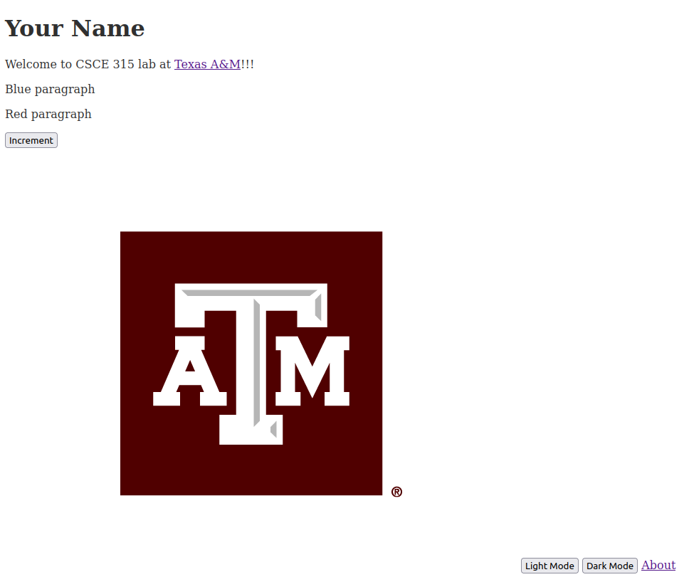
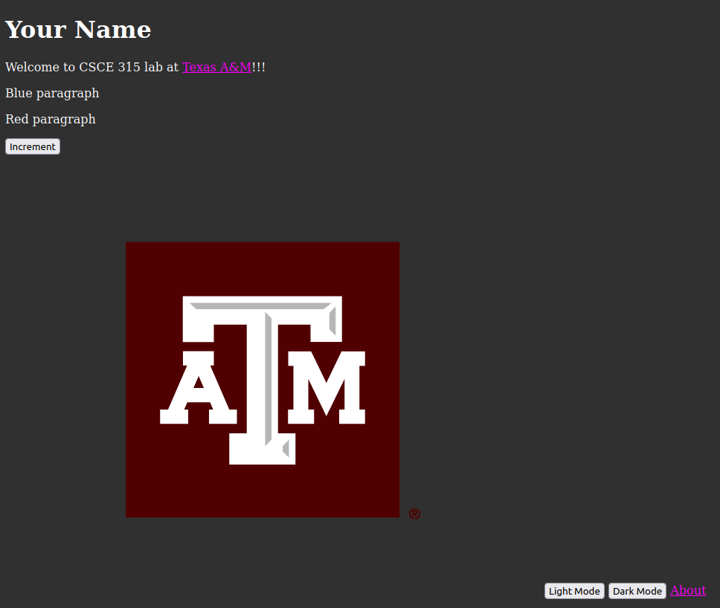
Light vs. Dark Mode

Slide 17
Lab Activity: Website Peer Review
Critique each other’s website at your table
For tables of 1, join another table
For tables of odd numbers, you can create a peer review cycle
Provide feedback for:
Professional presence
Any missing items from iteration 2
TA will go around and take attendance
Ask us any questions!

